Slide 1

Fundamentals of Data Science
International Master of Data Science
Fall and winter terms | 2025-26

Slide 2
Fundamentals of Data Science
CH.02 Statistical learning

Slide 3
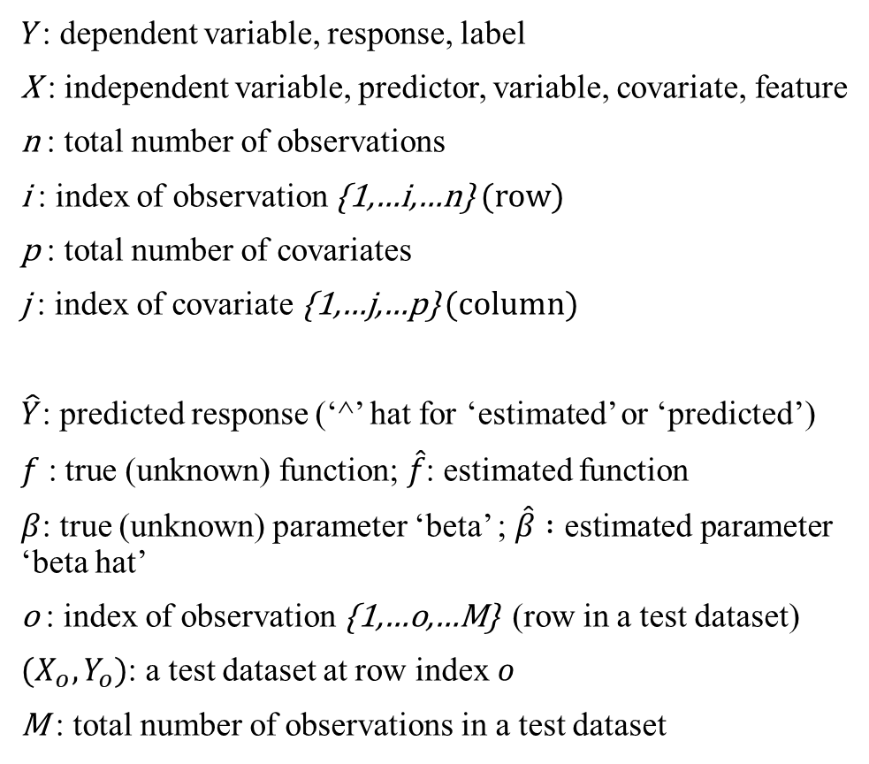
Notation
$Y$: dependent variable, response, label
X : independent variable, predictor, variable, covariate, feature
n : total number of observations
i : index of observation {1,…i,…n} (row)
p : total number of covariates
j : index of covariate {1,…j,…p} (column)
$\hat{Y}$: predicted response (‘^’ hat for ‘estimated’ or ‘predicted’)
$f \text{: }\text{true} \text{(}\text{unknown}\text{) }\text{function}\text{; }\hat{f}$: estimated function
$β$: true (unknown) parameter ‘beta’ ; $\hat{β} :\text{estimated} \text{parameter}$ ‘beta hat’
o : index of observation {1,…o,…M} (row in a test dataset)
${(X}_{o},Y_{o})$: a test dataset at row index $o$
M : total number of observations in a test dataset
My notes

Slide 4
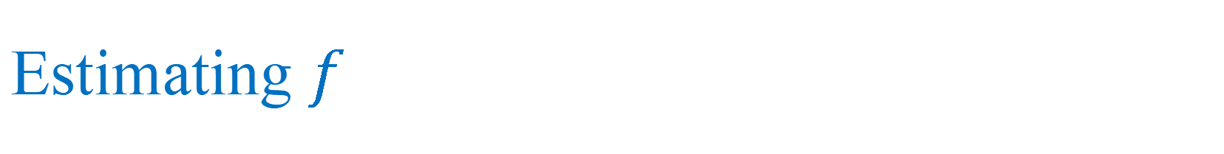
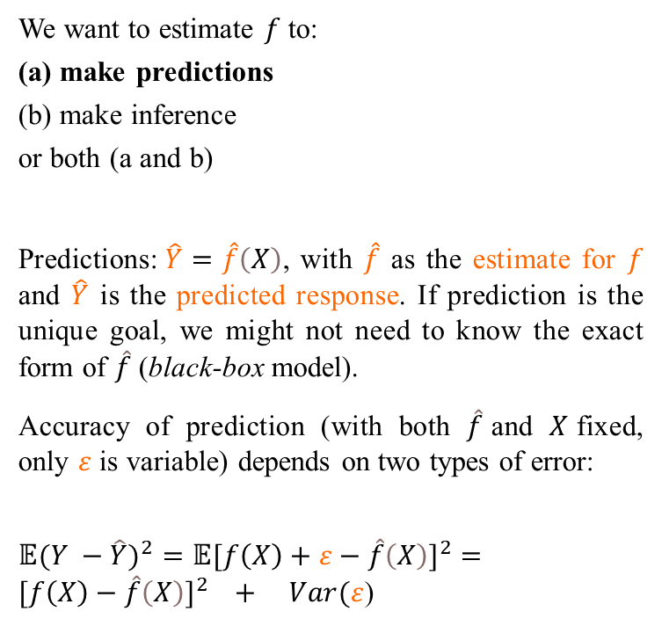
Estimating $f$
We want to estimate $f$ to:
(a) make predictions
(b) make inference
or both (a and b)
Predictions:$\hat{Y}=\hat{f}\left(X\right)$, with $\hat{f}$ as the estimate for $f$ and $\hat{Y}$ is the predicted response. If prediction is the unique goal, we might not need to know the exact form of $\hat{f}$ (black-box model).
Accuracy of prediction (with both $\hat{f}$and $X$fixed, only $ε$ is variable) depends on two types of error:
${𝔼(Y −\hat{Y})}^{2}={𝔼[f\left(X\right)+ε−\hat{f}\left(X\right)]}^{2}={[f\left(X\right)−\hat{f}\left(X\right)]}^{2} + Var(ε$)
My notes
reducible
non-reducible
$𝔼$ stands for ‘expectation of’: average with a very large $n.$
types of error

Slide 5
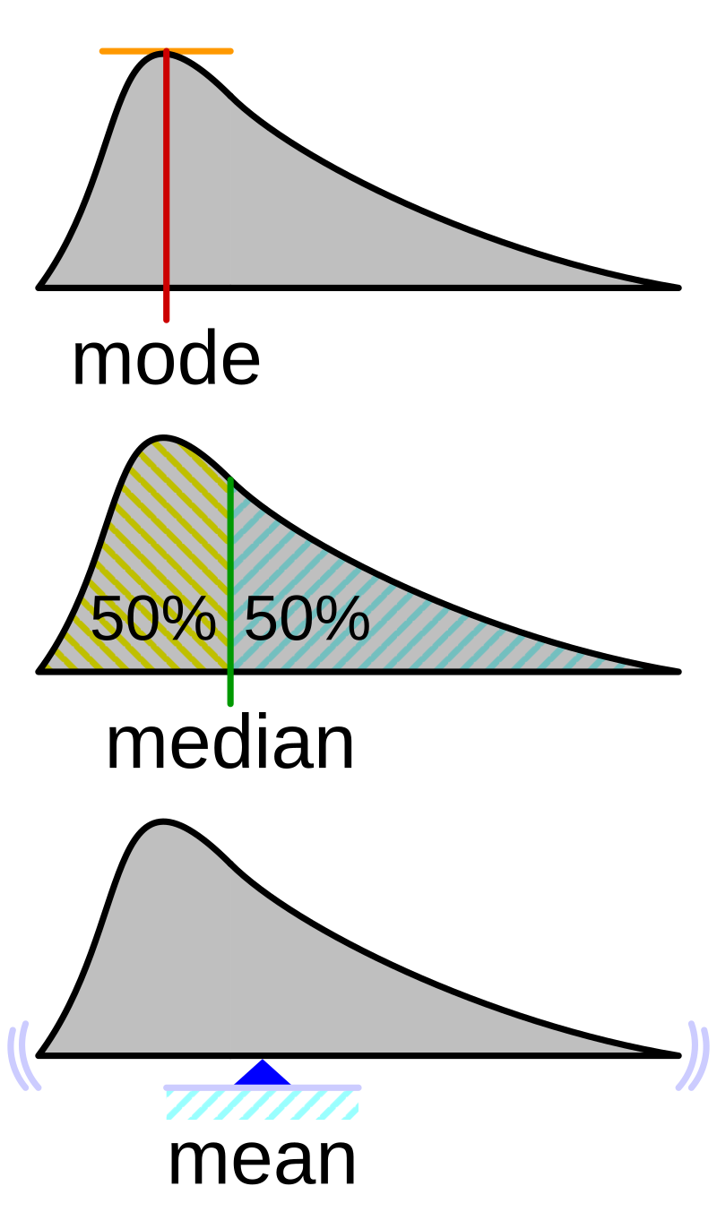
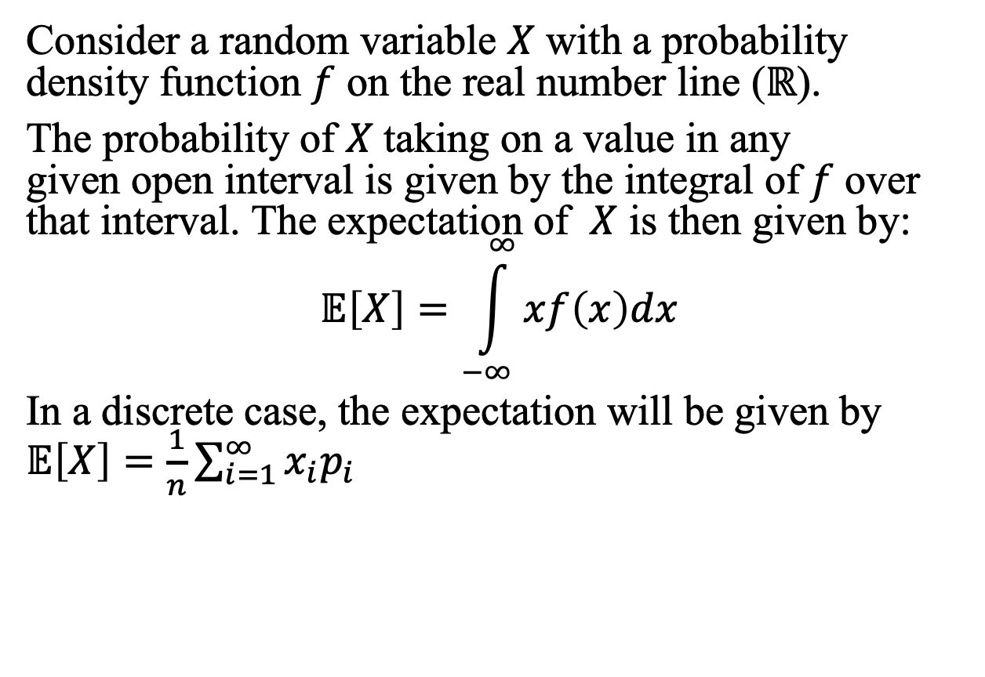
What ‘expectation’ means
Consider a random variable $X$ with a probability density function $f$ on the real number line ($ℝ$).
The probability of $X$taking on a value in any given open interval is given by the integral of $f$over that interval. The expectation of $X$ is then given by:
$$𝔼\left[X\right]=\int_{−∞}^{∞}{xf\left(x\right)dx}$$
In a discrete case, the expectation will be given by $𝔼\left[X\right]=\frac{1}{n}\sum_{i=1}^{∞}{x_{i}p_{i}}$

Slide 6
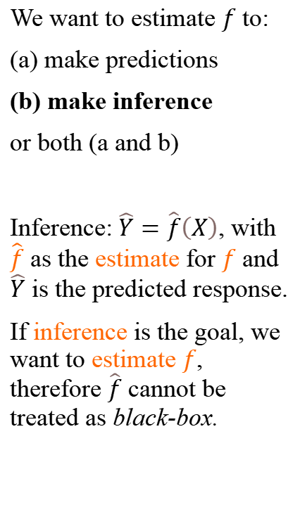
Estimating $f$
We want to estimate $f$ to:
(a) make predictions
(b) make inference
or both (a and b)
Inference:$\hat{Y}=\hat{f}\left(X\right)$, with $\hat{f}$ as the estimate for $f$ and $\hat{Y}$ is the predicted response.
If inference is the goal, we want to estimate $f$, therefore $\hat{f}$ cannot be treated as black-box.
Use examples to answer these questions
Which predictors are associated with the response?
What is the relationship between the response and each predictor?
Is the relationship between Y and each predictor linear or more complex?

Slide 7
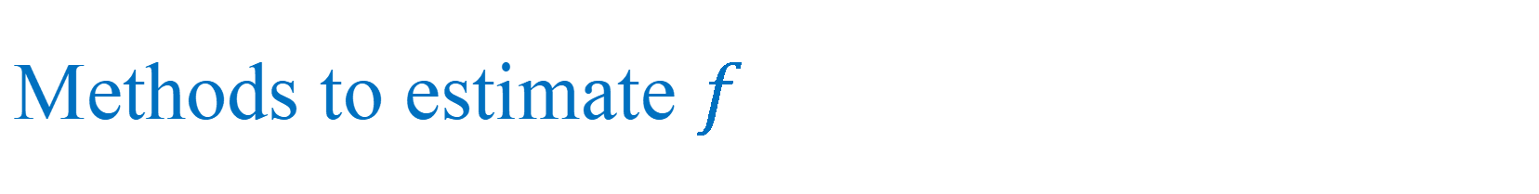
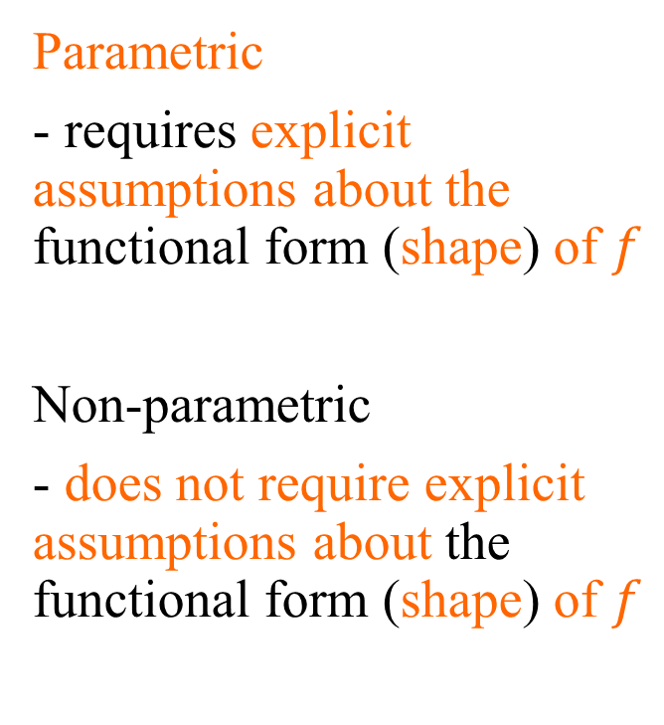
Methods to estimate $f$
My notes
Parametric
- requires explicit assumptions about the functional form (shape) of $f$
Non-parametric
- does not require explicit assumptions about the functional form (shape) of $f$

Slide 8
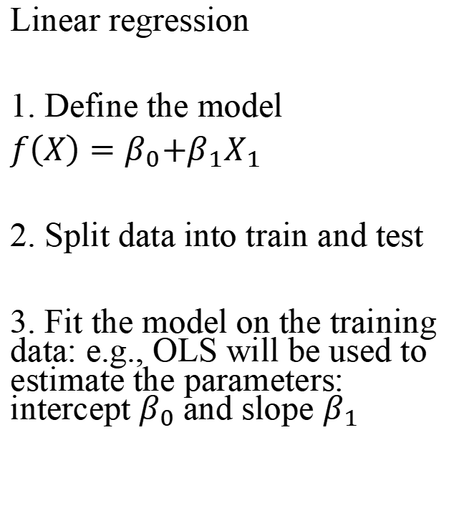
Example of parametric method
My notes
Linear regression
1. Define the model
$f\left(X\right)=β_{0}{+β}_{1}X_{1}$
2. Split data into train and test
3. Fit the model on the training data: e.g., OLS will be used to estimate the parameters: intercept $β_{0}$and slope $β_{1}$

Slide 9
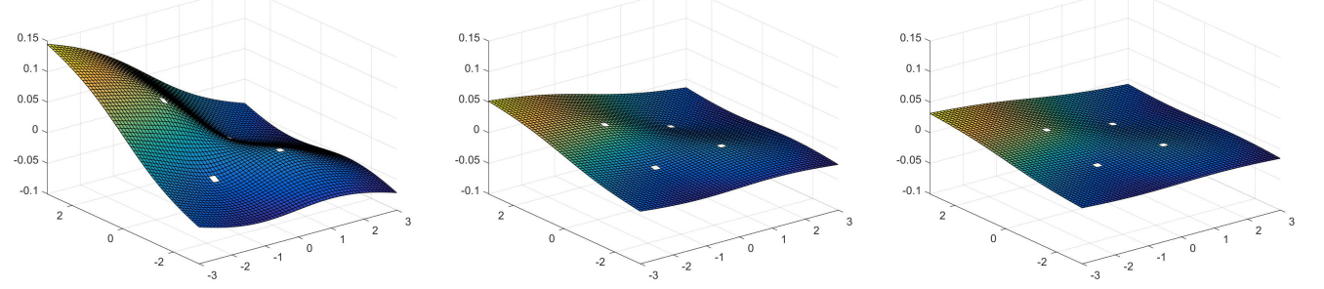
Example of a non-parametric method
Thin-plate spline model refers to a physical analogy involving the bending of a thin sheet of metal
Splines are among one of the most popular methods of data interpolation
smoothness
low medium high
mathworld.wolfram.com/ThinPlateSpline.html

Slide 10
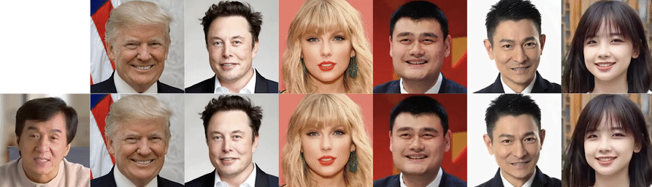
Extended thin-plate model to animate images
Image input
Video input
Video output
Thin-Plate Spline Motion Model for Image Animation
Zhao and Zhang, CVPR, 2022.
Paper: https://openaccess.thecvf.com/content/CVPR2022/papers/Zhao_Thin-Plate_Spline_Motion_Model_for_Image_Animation_CVPR_2022_paper.pdf

Slide 11
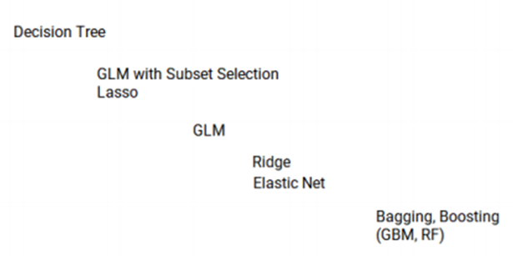
Interpretability versus flexibility
high
Linear regression
-Lasso
-OLS
Interpretability
low
Deep learning
low
high
Flexibility
Interpreted from:
https://sdcastillo.github.io/PA-R-Study-Manual/bias-variance-trade-off.html

Slide 12
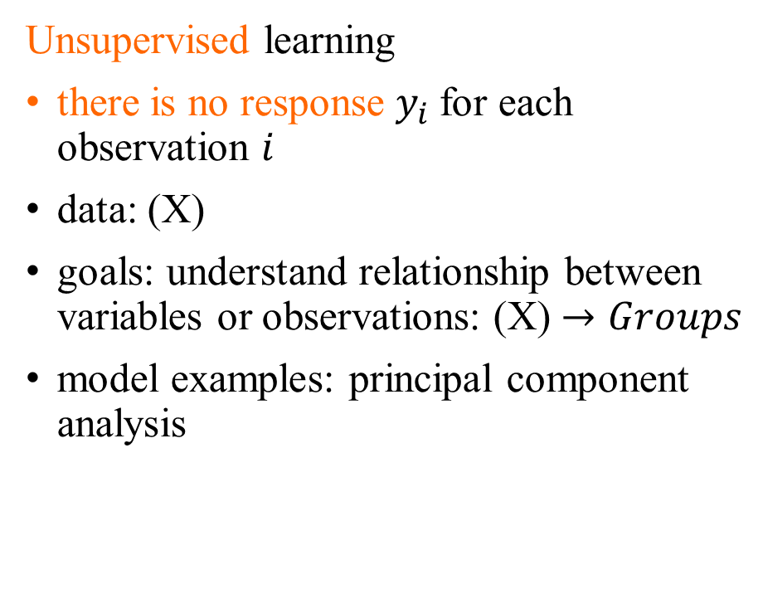
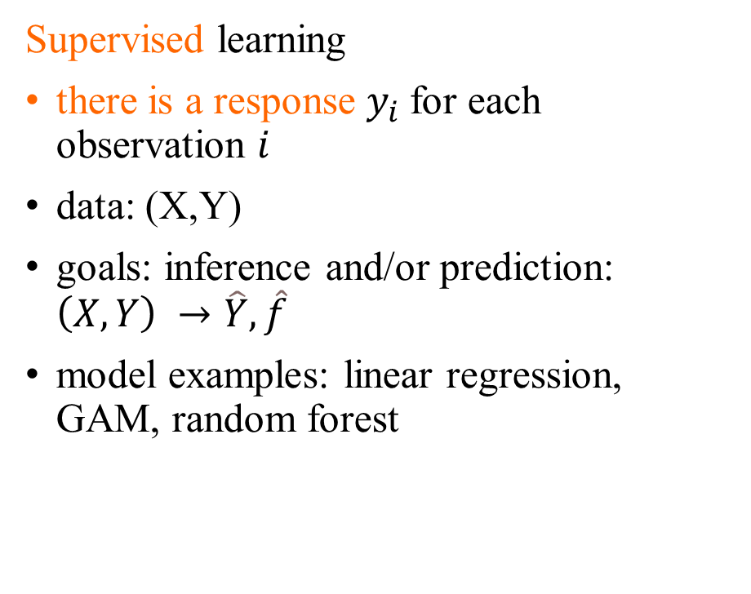
Supervised vs unsupervised learning
Supervised learning
there is a response $y_{i}$for each observation $i$
data: (X,Y)
goals: inference and/or prediction: $\left(X,Y\right) →\hat{Y},\hat{f}$
model examples: linear regression, GAM, random forest
Unsupervised learning
there is no response $y_{i}$for each observation $i$
data: (X)
goals: understand relationship between variables or observations: (X) $→Groups$
model examples: principal component analysis

Slide 13
Supervised learning
Regression
adapted to a quantitative response
continuous response:
linear regression
discrete response:
Count variable: Poisson, Binomial models
Classification
adapted to a qualitative response
binary response:
logistic regression
multi-class response:
logistic regression, K-nearest neighbors
My notes

Slide 14
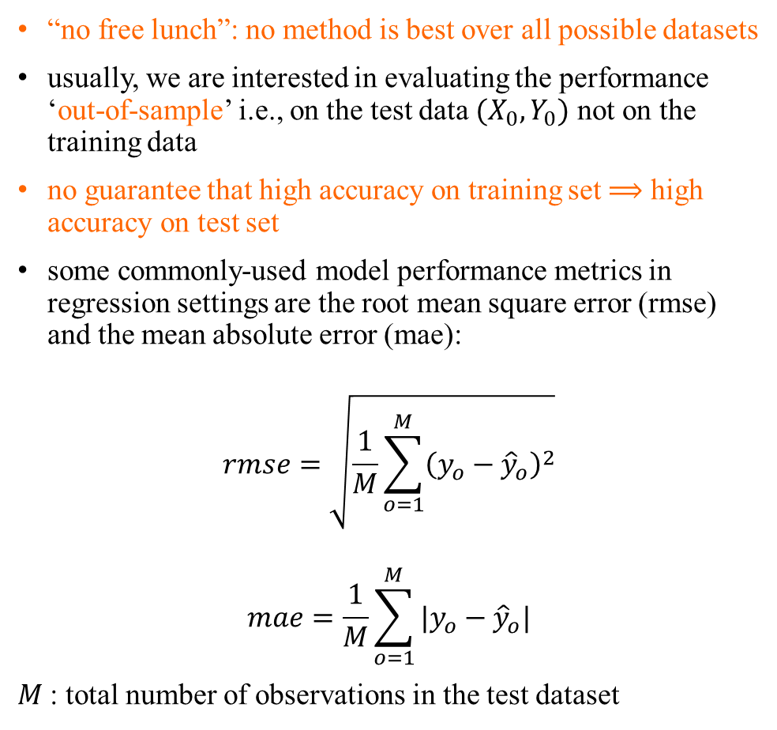
Model accuracy – regression setting
“no free lunch”: no method is best over all possible datasets
usually, we are interested in evaluating the performance ‘out-of-sample’ i.e., on the test data ${(X}_{0},Y_{0})$ not on the training data
no guarantee that high accuracy on training set $⟹$ high accuracy on test set
some commonly-used model performance metrics in regression settings are the root mean square error (rmse) and the mean absolute error (mae):
$$rmse=\sqrt{\frac{1}{M}\sum_{o=1}^{M}{{\left(y_{o}−{\hat{y}}_{o}\right)}^{2}}}$$
$$mae=\frac{1}{M}\sum_{o=1}^{M}{|y_{o}−{\hat{y}}_{o}|}$$
$M$: total number of observations in the test dataset
My notes
Notes:
Make an example with linear regression and say 4 test points and compute rmse and mae

Slide 15
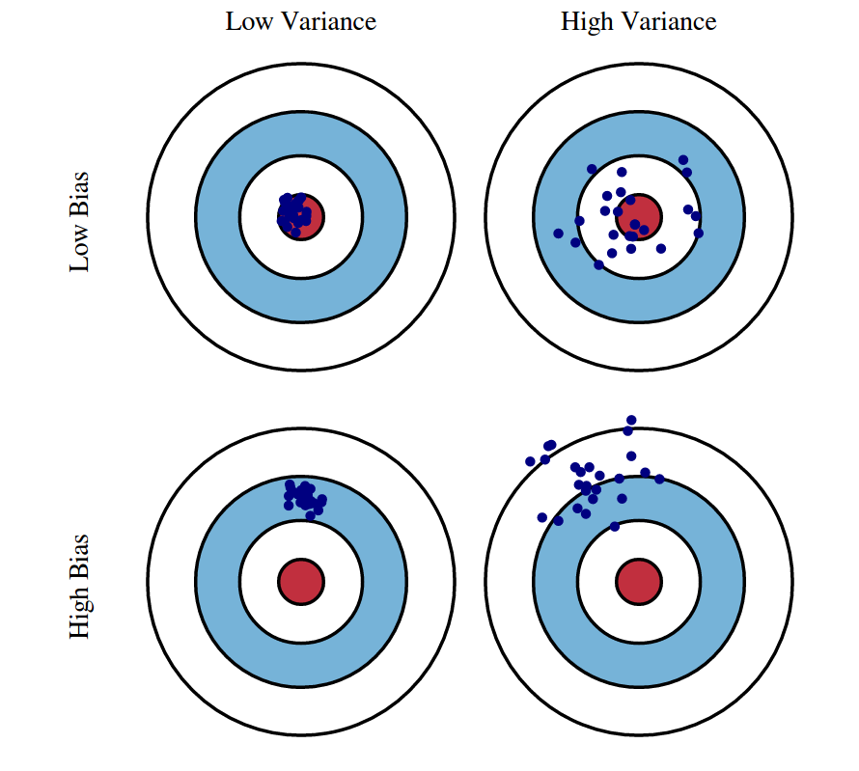
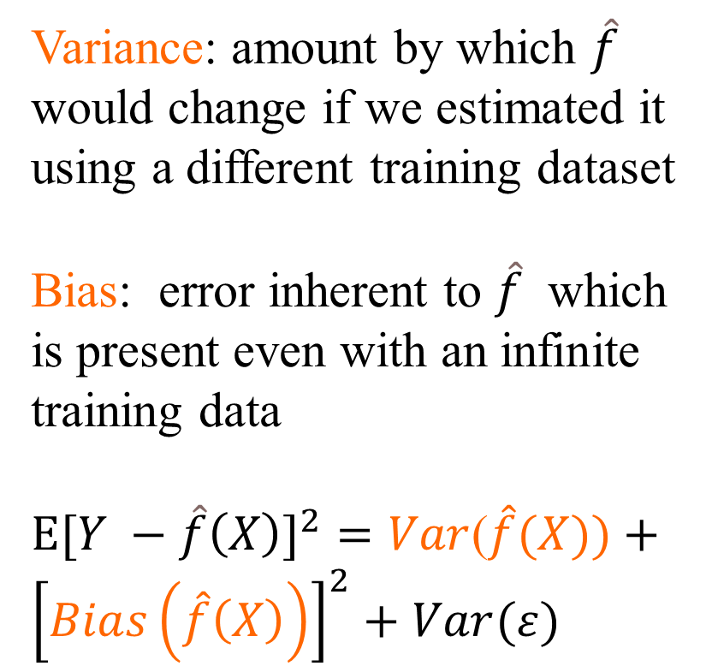
Variance – bias trade-off
Variance: amount by which $\hat{f}$ would change if we estimated it using a different training dataset
Bias: error inherent to $\hat{f}$ which is present even with an infinite training data
${Ε[Y −\hat{f}\left(X\right)]}^{2}=Var$($\hat{f}(X))+{\left[Bias\left(\hat{f}\left(X\right)\right)\right]}^{2}+Var(ε)$
Reducible error
From http://scott.fortmann-roe.com/docs/BiasVariance.html in: https://www.cs.cornell.edu/courses/cs4780/2018fa/lectures/lecturenote12.html
Notes:
More formally:
For a point estimator, statistical bias is defined as the difference between the parameter to be estimated and the mathematical expectation of the estimator.
Variance is the amount that the estimate of the target function will change if different training data was used

Slide 16

Variance – bias trade-off
Usually, more flexible/complex models have lower bias but higher variance
From http://scott.fortmann-roe.com/docs/BiasVariance.html in: https://www.cs.cornell.edu/courses/cs4780/2018fa/lectures/lecturenote12.html

Slide 17
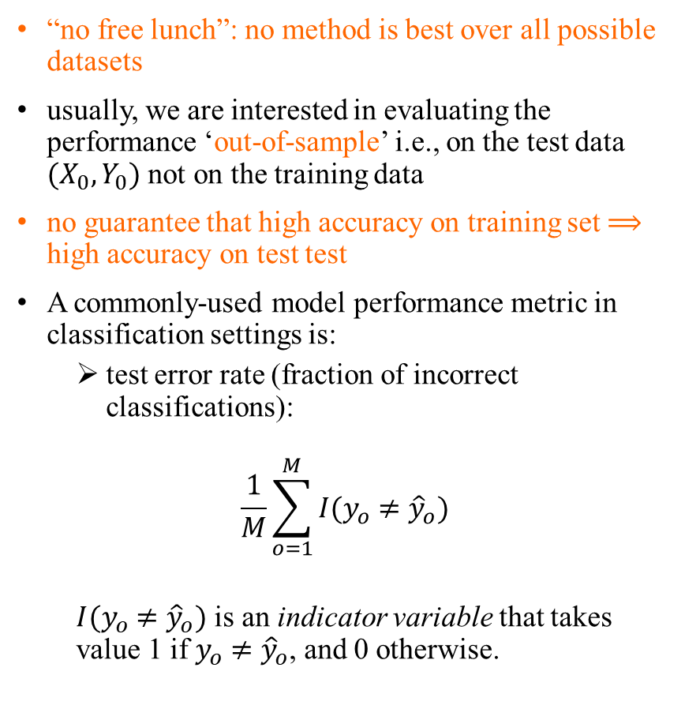
Model accuracy for classification
“no free lunch”: no method is best over all possible datasets
usually, we are interested in evaluating the performance ‘out-of-sample’ i.e., on the test data ${(X}_{0},Y_{0})$ not on the training data
no guarantee that high accuracy on training set $⟹$ high accuracy on test test
A commonly-used model performance metric in classification settings is:
test error rate (fraction of incorrect classifications):
$$\frac{1}{M}\sum_{o=1}^{M}{I(y_{o}{ ≠\hat{y}}_{o})}$$
$I(y_{o}{ ≠\hat{y}}_{o})$ is an indicator variable that takes value 1 if $y_{o}{ ≠\hat{y}}_{o}$, and 0 otherwise.
My notes
Identical to regression
Notes:
Make an example with logistic regression with 5 columns and M test rows: X0, Y0, \hatY0, and I. Then compute I

Slide 18
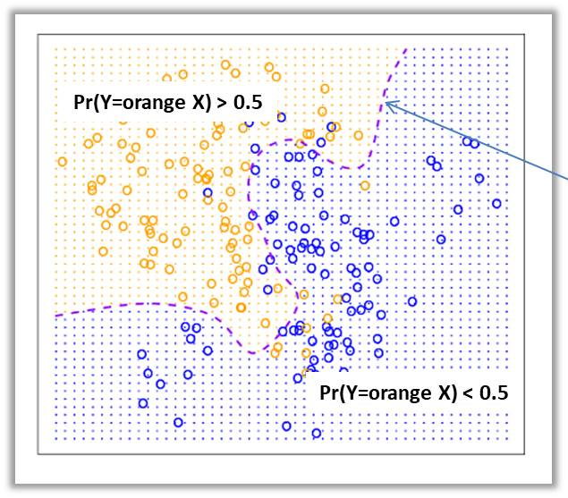
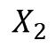
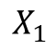
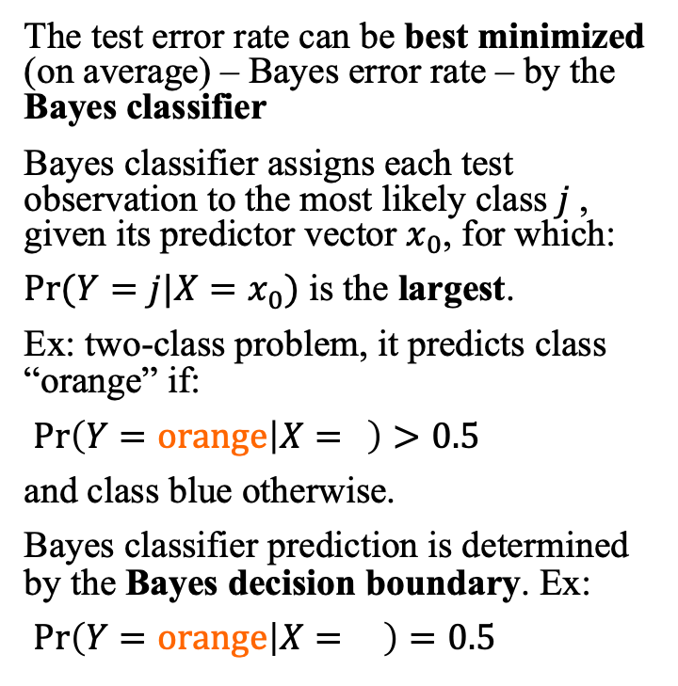
Bayes classifier
The test error rate can be best minimized (on average) – Bayes error rate – by the Bayes classifier
Bayes classifier assigns each test observation to the most likely class $j$, given its predictor vector $x_{0}$, for which:
$Pr⁡(Y=j|X=x_{0})$ is the largest.
Ex: two-class problem, it predicts class “orange” if:
$\operatorname{Pr}\left(Y=orange | X= \right)>0.5$
and class blue otherwise.
Bayes classifier prediction is determined by the Bayes decision boundary. Ex:
$\operatorname{Pr}\left(Y=orange | X= \right)=0.5$
Bayes decision
boundary
$$X_{2}$$
Grid points
$$X_{1}$$

Slide 19
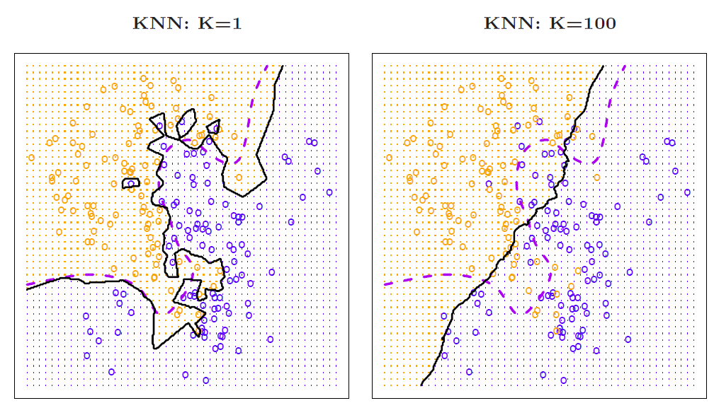
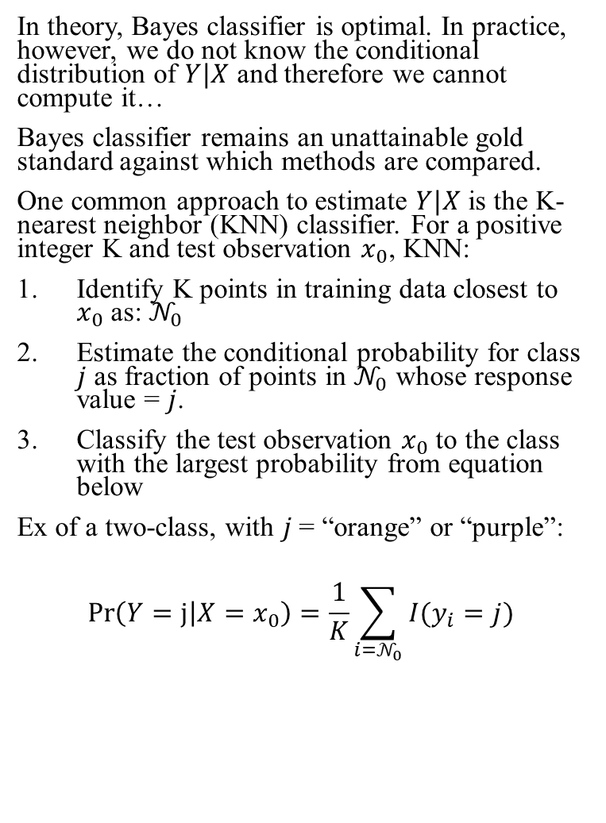
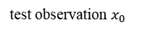
K-nearest neighbors
In theory, Bayes classifier is optimal. In practice, however, we do not know the conditional distribution of $Y|X$ and therefore we cannot compute it…
Bayes classifier remains an unattainable gold standard against which methods are compared.
One common approach to estimate $Y|X$ is the K-nearest neighbor (KNN) classifier. For a positive integer K and test observation $x_{0}$, KNN:
Identify K points in training data closest to $x_{0}$as: $𝒩_{0}$
Estimate the conditional probability for class $j$ as fraction of points in $𝒩_{0}$ whose response value = $j$.
Classify the test observation $x_{0}$to the class with the largest probability from equation below
Ex of a two-class, with $j$= “orange” or “purple”:
$$\operatorname{Pr}\left(Y=j | X=x_{0}\right)=\frac{1}{K}\sum_{i=𝒩_{0}}{I(y_{i}=j)}$$
decision boundary too flexible
decision boundary not flexible enough
test observation $x_{0}$
Bayes decision boundary
KNN decision boundary
K=1
K=100

Slide 20
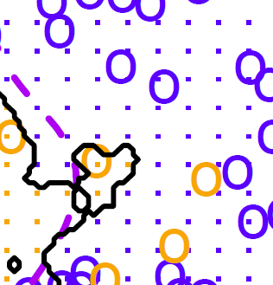
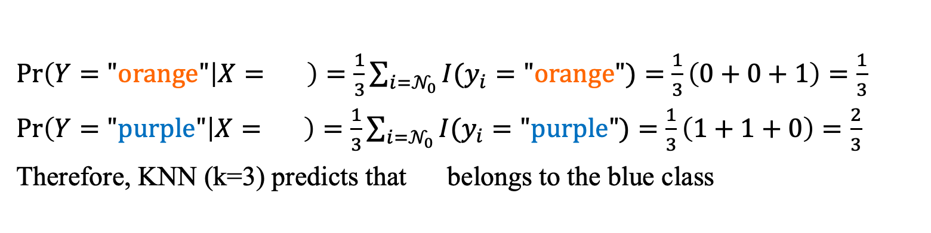
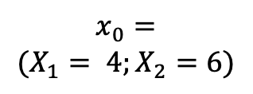
Example for K=3-nearest neighbor
$$x_{0}=$$
$$(X_{1}= 4;X_{2}=6)$$
$\operatorname{Pr}\left(Y="orange" | X= \right)=\frac{1}{3}\sum_{i=𝒩_{0}}{I(y_{i}="orange")}=$ $\frac{1}{3}\left(0+0+1\right)=\frac{1}{3}$
$\operatorname{Pr}\left(Y="purple" | X= \right)=\frac{1}{3}\sum_{i=𝒩_{0}}{I(y_{i}="purple")}=$ $\frac{1}{3}\left(1+1+0\right)=\frac{2}{3}$
Therefore, KNN (k=3) predicts that belongs to the blue class
grid point
$$X_{2}$$
$$X_{1}$$

